Slide 1
MARKETING

Slide 2
COMPANY AND MARKETING STRATEGY

Slide 3
Understanding Mission, Vision and Values

Slide 4
Core Values, Vision, and Mission are crucial to setting clear, understandable, and easily communicated direction for yourself, your partners and employees, and your investors and customers.
Core values are 3-5 terms that describe the forces that drive you to form and grow your organization.
Vision A Vision Statement is the reason your company exists it’s a description of the desired future state of the company
Mission a definition of the company's business, who it serves, what it does, its objectives, and its approach to reaching those objectives.

Slide 5
Why do you choose to buy products and services from certain brands even when cheaper options exist?

Slide 6
Mission Statement
A mission statement is a simple statement about the goals, values, and objectives of an organization. A mission statement summarizes why a business exists and helps a company respond to change and make decisions that align with its vision.
A good mission statement will not only explain your brand’s purpose but will also foster a connection with customers.

Slide 7
Three parts of a Mission Statement
Brand purpose. What does your product or service do or aim to offer and for whom?
Brand values. What does your company stand for? Values are what make your company unique.
Brand goals. What does your company accomplish for customers? Why should they purchase from you instead of other competitors?

Slide 8
Steps for writing a good mission statement
Explain your company’s product or service offering.
Identify the company’s core values.
Connect how your company’s offering aligns with your values.
Condense these statements into one.
Refine your mission statement.

Slide 9
Business Portfolio
it's the collection of all the businesses and products that make up your company. The best business portfolio is one that fits your company's strengths and weaknesses to the opportunities in your environment.
There are two steps to plan the portfolio:
Analyze your current business portfolio
Develop strategies for growth

Slide 10
Framework for Business Portfolio Design
Analysis of a product portfolio requires six major steps:
1. Establishing the level and unit of analysis and determining what links connect them.
2. Identifying the relevant dimensions.
3. Determining the relative importance of the dimensions.

Slide 11
4. Locating the products or businesses on the relevant portfolio dimensions.
5. Projecting the likely position of each product or business on the dimensions
6. Selecting the desired position for each existing and new product (as a basis for developing alternative strategies to close the gap between the current and new portfolios) and deciding how resources might best be allocated among these products.

Slide 12
BCG Matrix

Slide 13
BCG Matrix
Stars: High-growth, high-share businesses or products. Sometimes, stars need heavy investments to finance their rapid growth but eventually, growth will slow and they'll turn into cash cows.
Cash Cows: Low-growth, high-share businesses or products. Produce cash that you can use to pay your bills and support other SBUs.
Question Marks: Low-share business units in high-growth markets. They need a lot of cash to hold their share.
Dogs: Low-growth, low-share businesses and products. They could generate cash but they don't promise to be large sources of cash.

Slide 14
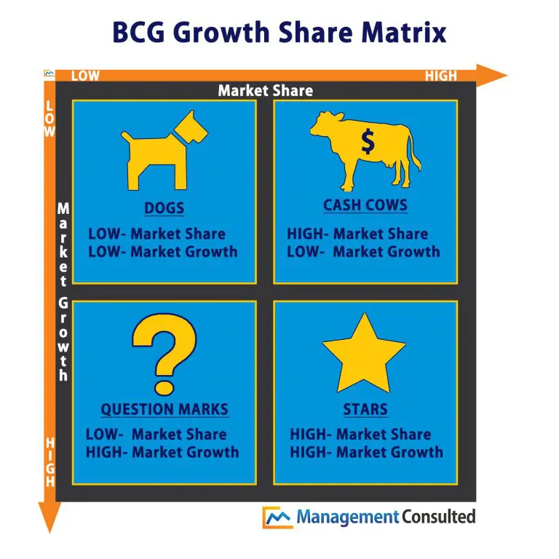

Slide 15
